Slide 1


Final Presentation on API Market Research: Data collection and Database handling
Case Study Intelligent Systems in Production
Presented by:
Neethu Bojanapati (00812978)
Samyuktha Maddela (00812383)
Sandeep Das (22302608)
Shashank Sakhala (12405023)
Supervised by Prof. Tim Weber

Slide 2

Contents:
Overview
Background
Data collection
Data storage
Visualization
Docker Containerisation
Conclusion

Slide 3



Overview
Objective ​
​
The project aims to collect, store, and analyze market data on ​Arduino UNO
Scope​
​
The focus is on tracking price trends, sales volumes, and availability to provide insights for better decision-making in purchasing, pricing, inventory and supply management for suppliers, manufacturers, and consumers.
Case study
To validate our approach, we are using Nexar API to collect data​.

Slide 4
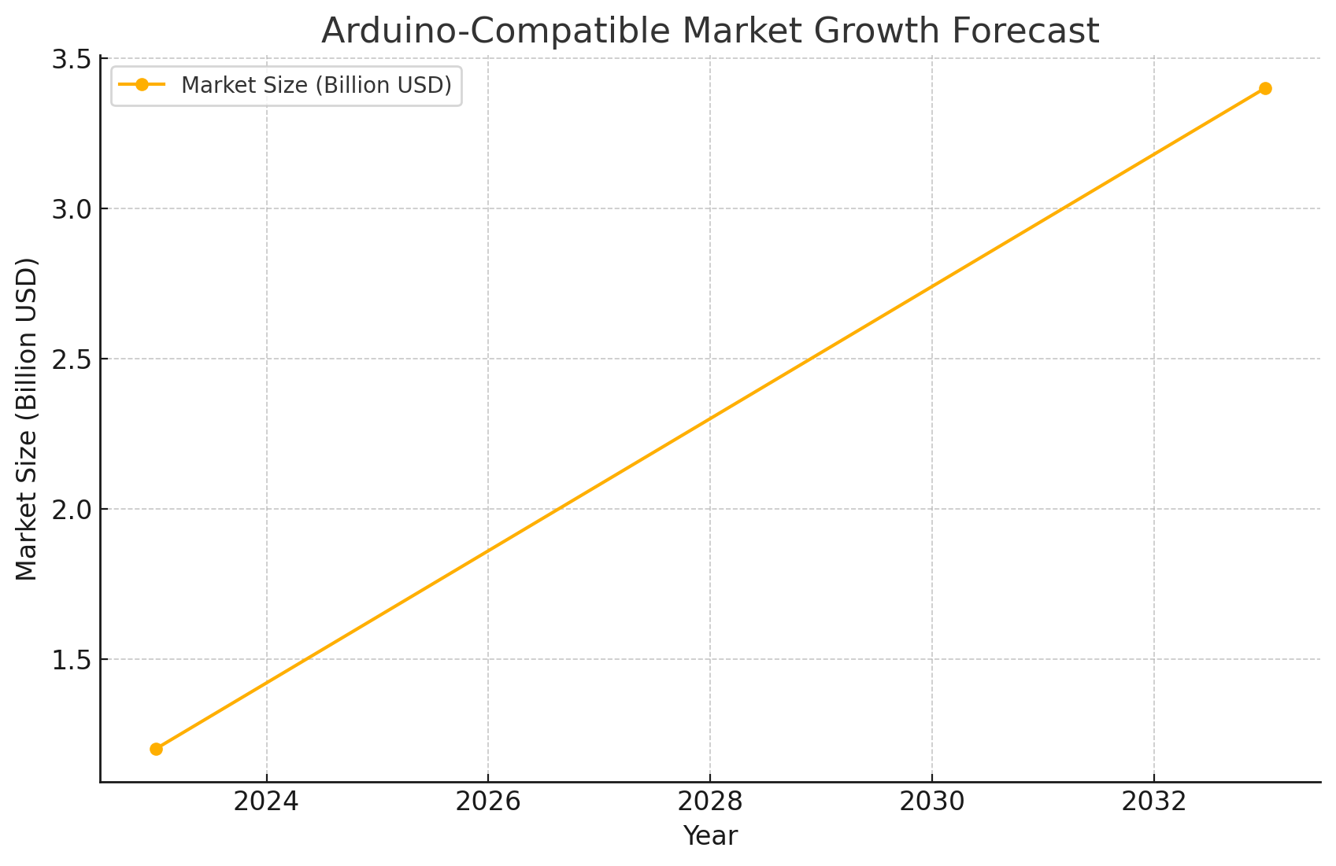
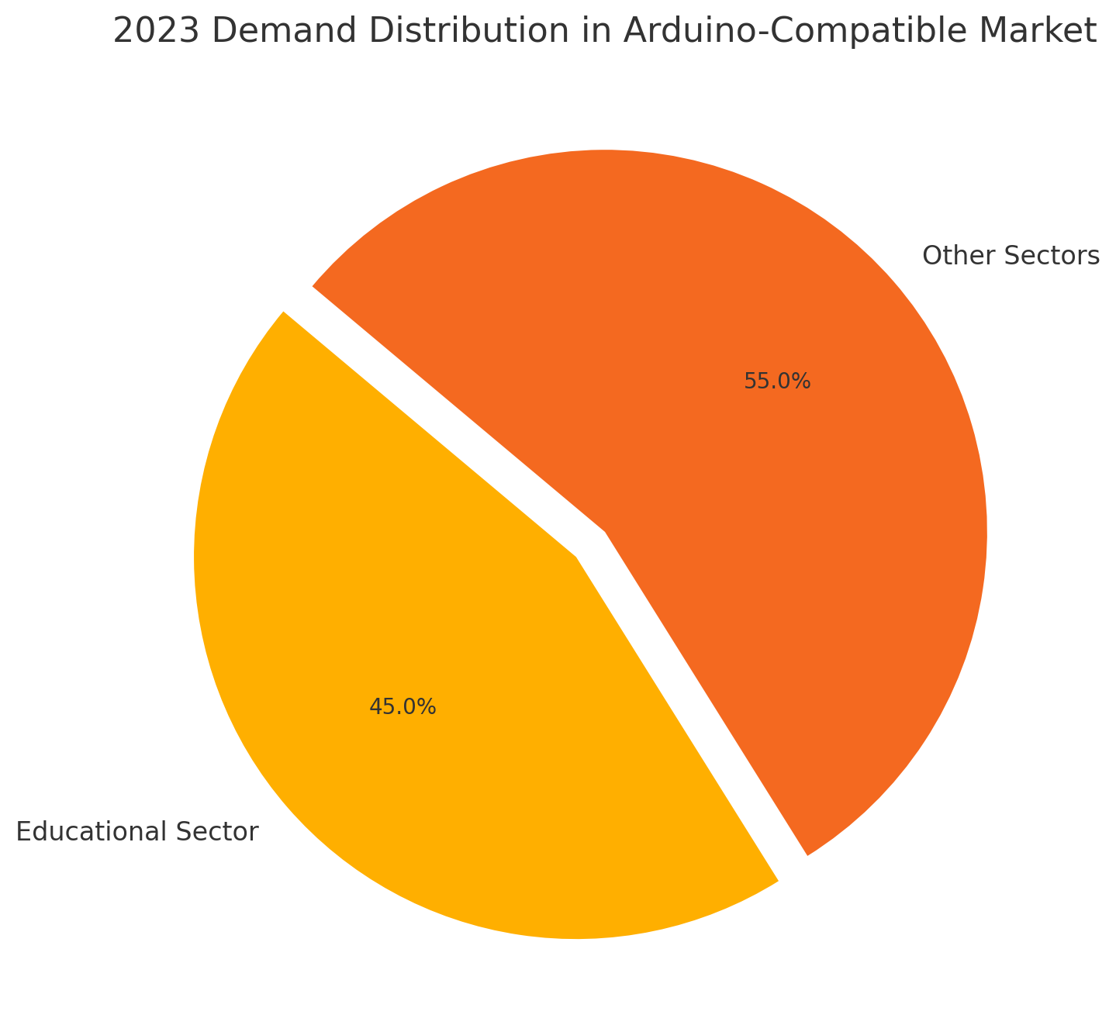
Background : Market Overview
The Arduino-compatible market is rapidly expanding, driven by growth in IoT, educational, and DIY electronics sectors.[4]
In 2023, market volume reached 5.2 million units, with 45% of demand from the educational sector.[1]
Market Forecast: Expected growth from $1.2 billion (2023) to $3.4 billion (2033) at a CAGR of 10.7%.[1]
Figure 1: Arduino Market demand

Slide 5
Background : Market Overview
Key Trends and Innovations
Product advancements such as the Arduino UNO SPE Shield (2024) highlight innovations like Single-Pair Ethernet (SPE) and RS485 for industrial communication.[5]
Strategic focus on IoT accessibility and cloud integration strengthens Arduino’s position in industrial IoT. [4]
Regional Dynamics [3]
North America: Leading market.
Europe: Steady growth.
Asia Pacific: Rapid expansion potential.
Research Gap
Existing studies overlook detailed component-level data (e.g., price, sales volume, availability).

Slide 6
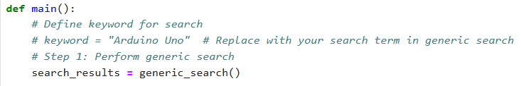
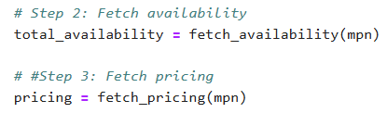
Data Collection
Figure 2: Data collection code snippet

Slide 7
Data Storage: SQLite Database
Parts
Column Name | Data Type
mpn (PRIMARY KEY) | STRING
keyword | STRING
part_id | STRING
part_name | STRING
manufacturer_name | STRING
manufacturer_id | STRING
Prices
Column Name | Data Type
price_id (PRIMARY KEY) | INTEGER
date | TEXT
keyword | STRING
company_name | STRING
quantity | INTEGER
currency | REAL
Price | REAL
conversionRate | REAL
convertedCurrency | TEXT
convertedPrice | REAL
mpn (FOREIGN KEY) | STRING
Availability
Column Name | Data Type
id (PRIMARY KEY) | INTEGER
date | TEXT
total_availability | INTEGER
mpn (FOREIGN KEY) | STRING
Figure 3: SQLite Datable Tables

Slide 8

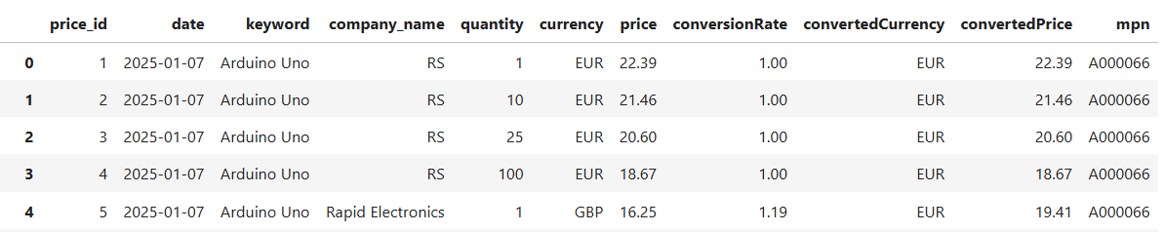
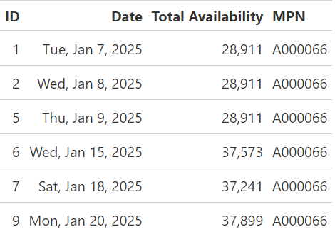
Data Storage: SQLite Database
Parts Table
Price Table
Availability Table
Figure 4: SQLite Database

Slide 9
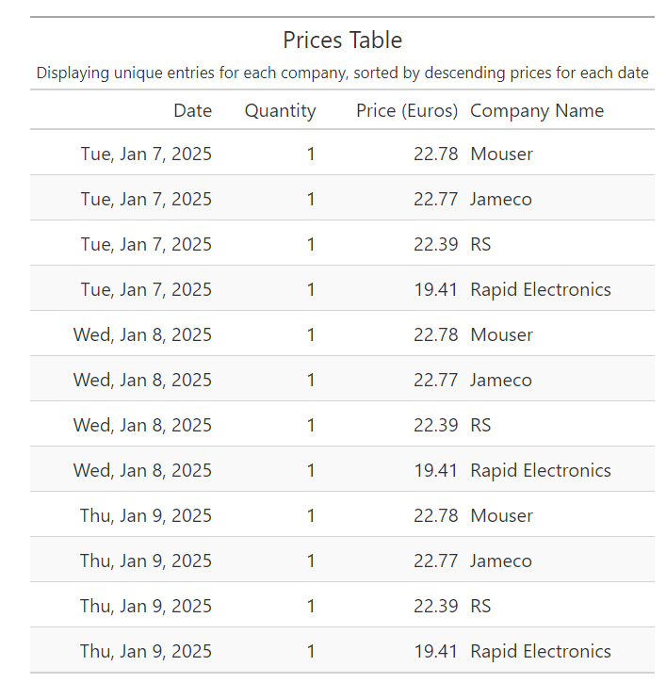
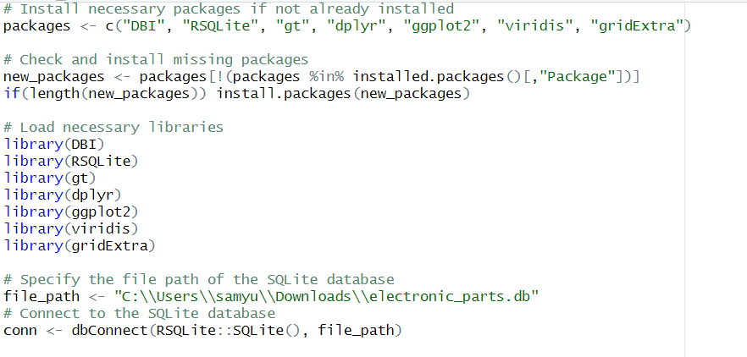
Visualization
We have retrieved the data from SQLite database electronic_parts.db
Figure 4: screenshot of creating connection to DB in R programming
Figure 5: screenshot of Prices Table

Slide 10
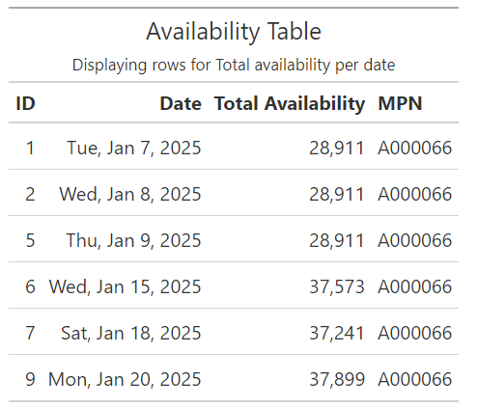
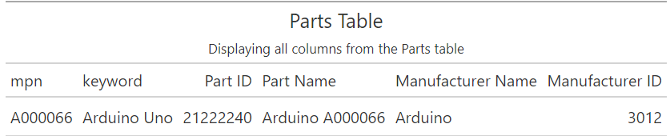
Visualization: Table data
Figure 6: Availability Table
Figure 7: Parts Table

Slide 11
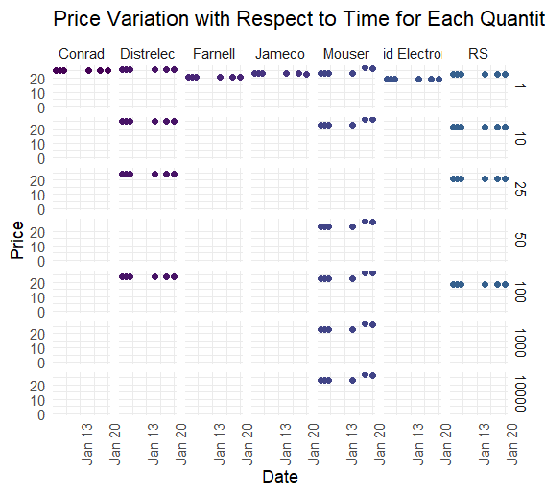
Visualization: Facet grid scatter plot
X-axis: Represents the Date (from January 13 to January 20).
Y-axis: Represents the Price. indicates the price values ranging from 0 to 20.
Most companies have consistent prices over the given time period.
Companies like Jameco,Mouser and id Electro shows higher prices
Figure 8: Facet grid scatter plot of Price vs Time

Slide 12
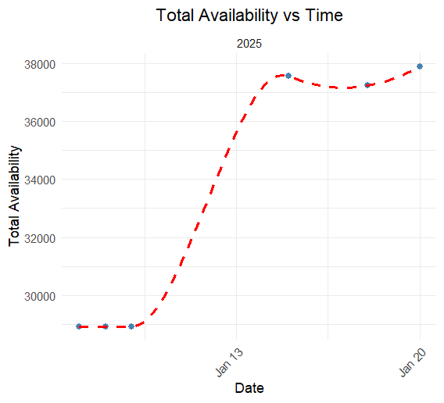
Scatter plot with a dashed line
This graph in Figure 9 depicts the Total Availability vs. Time for the year 2025
Blue dots indicate the actual recorded availability on specific dates.
Red dashed line represents a smoothed trend line.
The dashed line becomes steeper after January 13th, indicating an acceleration in availability growth during this period.
Figure 9: Scatter plot of Total Availability vs Date

Slide 13
Conclusion
The study looked at price, part and availability table of Arduino UNO components, providing insights into how to improve purchasing, pricing, and supply chain management.
The research used the Nexar API for data collecting, SQLite for storage, and R for visualization, resulting in a scalable approach for various markets.
The data covers the period from January 7th to 20th, 2025 and the table highlights the quantities sold at the highest prices across the top four companies, providing insights into competitive pricing strategies.
Certain companies, Jameco, Mouser and id Electro, charge premium prices (above 20 Euros) even less quantities to target customers willing to pay for higher quality, exclusivity, or additional services

Slide 14
References
Global Insight Services, Arduino Compatible Market Analysis and Forecast to 2033: Type, Product, Services, Technology,Component, Application, End User, Functionality, Installation Type, Equipment, 2025. https://www.giiresearch.com/report/gis1632992-arduino-compatible-market-analysis-forecast-type.html/Accessed: 2025-01-19.
qyreports, Global Arduino Market: The Booming Market Showing Growth Prospects, Market Trend by 2025: Key Players– Arrow Electronics, Digi-Key Corporation, Mouser Electronics, Premier Farnell, 2018.https://www.openpr.com/news/1153282/Accessed: 2025-01-19.
QYResearch, Global Arduino Development Kit Market Insights, Forecast to 2030, 2024. https://www.qyresearch.com/reports/2776834/arduino-development-kit/Accessed: 2025-01-19.
d5lsf, Arduino Development Kit Market 2024 Continuous, n.d. https://www.linkedin.com/pulse/arduino-development-kit-market-2024-continuous-d5lsf/Accessed: 2025-01-19.
Arduino Team, UNO Rev3 or UNO R4: Choosing the Perfect Arduino for Your Project, 2024. https://blog.arduino.cc/2024/12/18/uno-rev3-or-uno-r4-choosing-the-perfect-arduino-for-your-project/Accessed: 2025-01-19.
Nexar, API Documentation, n.d. https://nexar.com/api/Accessed: 2025-01-19.

Slide 15
References
Raji, Mustafa Ayobami, Olodo, Hameedat Bukola, Oke, Timothy Tolulope, Addy, WilhelminaAfua, Ofodile, Onyeka Chrisanctus, and Oyewole, Adedoyin Tolulope, E-commerce and consumerbehavior: A review of AI-powered personalization and market trends, GSC Advanced Researchand Reviews, Vol. 18, No. 3, pp. 66–77, 2024. https://gsconlinepress.com/journals/gscarr/content/e-commerce-and-consumer-behavior-review-ai-powered-personalization-and-market-trends/Accessed: 2025-01-19.
https://miro.medium.com/v2/resize:fit:734/1*ZBg67dw0eIbdIGe_XSVrwQ.png

Slide 16

Docker Containerization
Steps:
Set Up Project Directory
Create Shell Script
Create Dockerfile
Build Docker Image
Run Docker Container
Saving output
Figure 10: Docker[8]

Slide 17


